Slide 1
ML algorithm

Slide 2
Classification
Desired classifiers in this lecture
k-Nearest Neighbors: k-Neighbors classification, k-neighbors regression
Linear Models: Linear models for regression or logistic regression
Naive Bayes Classifiers
Decision Trees
Random forests
Support Vector Machines (SVM)
Hands on session in google colab

Slide 3
Evaluating classifiers
Given a test set and a specific classifier, you can place each decision as:
a positive example classified as positive. This is a true positive.
a positive example misclassified as negative. This is a false negative.
a negative example classified as negative. This is a true negative.
a negative example misclassified as positive. This is a false positive.

Slide 4
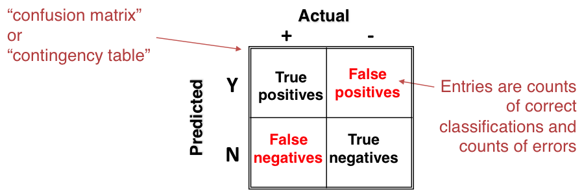
Evaluating classifiers (cont’d)
We can create a 2×2 matrix with the columns as true classes and the rows as the hypothesized classes. It looks like this:

Slide 5
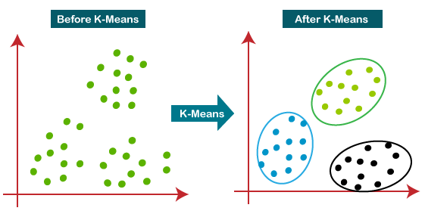
Clustering
Clustering
k-means
mixture models
hierarchical clustering: agglomerative, and divisive

Slide 6
10
10
9
9
8
8
7
7
6
6
5
5
4
4
3
3
2
2
1
1
0
0
1
2
3
4
5
6
7
8
9
10
0
0
1
2
3
4
5
6
7
8
9
10
Step 4

Slide 7
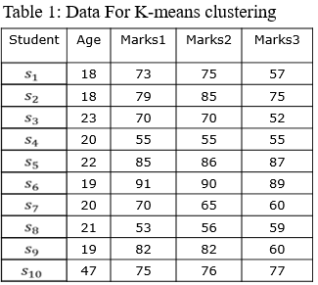
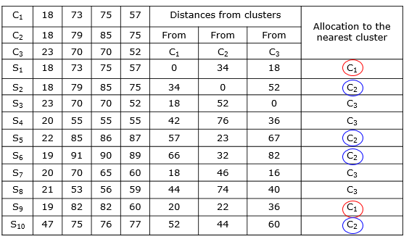
K-means clustering
Consider the sample dataset table for our analysis

Slide 8
Machine Learning Process
Step 1 : Import the libraries
Step 2 : Import the data-set
Step 3 : Check out the missing values
Step 4: handling the missing values
Step 5 : Splitting the data-set into Training and Test Set
Step 6 : Train and build model
Step 7: Evaluation

Slide 9

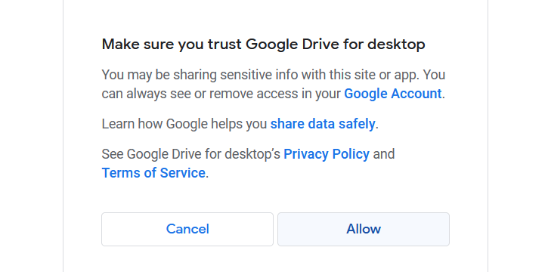
How to mount the drive
from google.colab import drive
drive.mount(‘/content/drive')

Slide 10
Import the libraries/Dataset
Importing the libraries
import numpy as np
import pandas as pd
Reading the Dataset
data=pd.read_csv('diabetes.csv’)
For google-colab:
data=pd.read_csv('/content/drive/MyDrive/Colab Notebooks/diabetes.csv')

Slide 11
Analysis the dataset
Show the shape
data=pd.read_csv('diabetes.csv’)
data.shape
data.describe()
data.describe().T
data.dtypes
data.columns
data['Pregnancies'].dtype

Slide 12
Check out the missing values
data.isnull().values.any()
data.isnull().sum()
data.isnull()
data.isnull().sum().sum()

Slide 13
List the columns with missing value
columnwithnull=data.columns[data2.isnull().any()].tolist()
for column in columnwithnull:
print("The average values of",column, "is : ", data2[column].mean())
for column in columnwithnull:
data2[column].fillna(data2[column].mean())

Slide 14
Fill with column average
for column in columnwithnull:
data2[column].fillna(data2[column].mean())
for column in columnwithnull:
data2[column].fillna(data2[column].mean(), inplace=True)
data2.isnull().sum()

Slide 15
Data Frames: method iloc
df.iloc[:, 0] # First column
df.iloc[:, -1] # Last column
row2 = data.iloc[4:8]

Slide 16
ML approach
Step 4.1 : split the data set into dependent and independent variable
train=data2.iloc[:,:-1]
test=data2.iloc[:,8]

Slide 17
Linear Regression
Step 4.2 : Split into test and train then build the model
from sklearn.model_selection import train_test_split
X_train,X_test,Y_train,Y_test=train_test_split(train,test, random_state=0,test_size=.2)
X_train
X_train.shape
from sklearn.linear_model import LogisticRegression
model=LogisticRegression(solver='lbfgs',max_iter=200)
model.fit(X_train,Y_train)

Slide 18
Linear Regression
Step 4.2 : Predict from the model
from sklearn.linear_model import LogisticRegression
model=LogisticRegression(solver='lbfgs',max_iter=200)
model.fit(X_train,Y_train)
Y_predictions = model.predict(X_test)
from sklearn.metrics import accuracy_score
from sklearn.metrics import confusion_matrix

Slide 19
Linear Regression
Step 5: Evaluate the model
from sklearn.metrics import accuracy_score
from sklearn.metrics import confusion_matrix
accuracy_LR=accuracy_score(Y_test, Y_predictions)
accuracy_LR
confusion_matrix(Y_test,Y_predictions)

Slide 20
SVM
Step 5: Evaluate the model
from sklearn.svm import SVC
smodel = SVC(C=1000.0, random_state=1, kernel='linear')
smodel.fit(X_train,Y_train)
Y_predictions = smodel.predict(X_test)
accuracy_SVM=accuracy_score(Y_test, Y_predictions)
accuracy_SVM
confusion_matrix(Y_test,Y_predictions)

Slide 21
DT
Step 5: Evaluate the model
from sklearn.tree import DecisionTreeClassifier
DTmodel = DecisionTreeClassifier()
DTmodel.fit(X_train,Y_train)
Y_predictions = DTmodel.predict(X_test)
accuracy_DT=accuracy_score(Y_test, Y_predictions)
accuracy_DT
confusion_matrix(Y_test,Y_predictions)

Slide 22
Finally Visualize the Results
import matplotlib.pyplot as plt
fig = plt.figure()
Model = ['LR', 'SVM', 'DT']
Results = [accuracy_LR,accuracy_SVM,accuracy_DT]
plt.bar(Model,Results)
plt.show()
import matplotlib.pyplot as plt
fig = plt.figure()
Model = ['LR', 'SVM', 'DT']
Results = [accuracy_LR*100,accuracy_SVM*100,accuracy_DT*100]
plt.xlabel("Model")
plt.ylabel("Accuracy")
plt.bar(Model,Results)
plt.show()

